Slide 1
Test Automation
Bugs are Features Too, Two
Team 7 - Cloud 9
Presented by: Alex Reel, Alex Tanner, Camron Savage, Yankai Zhao, Patrick Yoder, and Benjamin Ellis

Slide 2

Project Overview
Customer - Ben Fox - Trissential
Trissential - Software Quality Assurance
Needs
Functionality and appearance improvements
Additional bugs for more diverse debugging
Why?
Employee training and testing
Demonstration Services to current and potential clients
Providing a more modern, realistic feel to improve performance

Slide 3
Presentation Overview
Architecture
Web Interface, Database Layer, Web Server, Email Relay
Methods
Implementation
GUI, WishList, Database, Bug Testing
Demonstration
Testing
Maintenance
Metrics

Slide 4
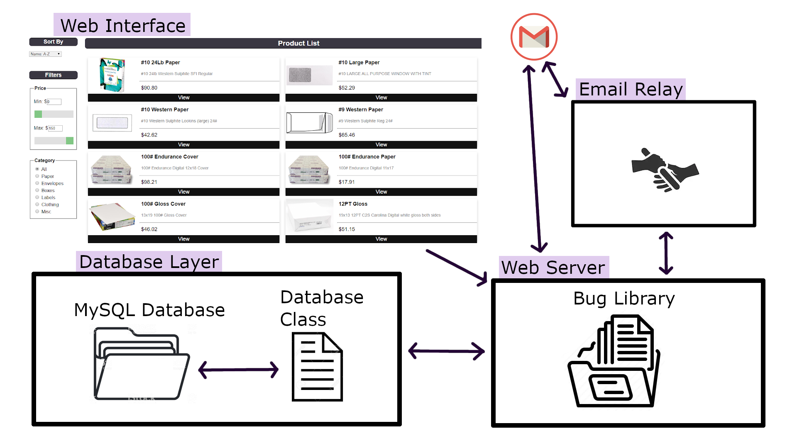
Architecture

Slide 5
Testing
Decided to focus on manual testing rather than implementing test automation.
Unit tests on the new features were the focus with additional integration tests to ensure proper implementation with existing code.
Testing results were positive overall.
Unfinished elements of product editing was discovered (now fixed).
Checkout form broken (now fixed).
An issue was found that sometimes causes a product to be hidden when it shares a name with an existing product (unresolved).

Slide 6
Maintenance
Project was already in progress when we adopted it, and was built by the previous team to be very modular
This was a specific strength of the project identified by the customer, as versions of the project before this one were not modular and groups had trouble understanding it
The project is html and php, with clear IDs and names that make it easy to slot in new functions
The project is extensively documented by both the previous group and now ours as well

Slide 7
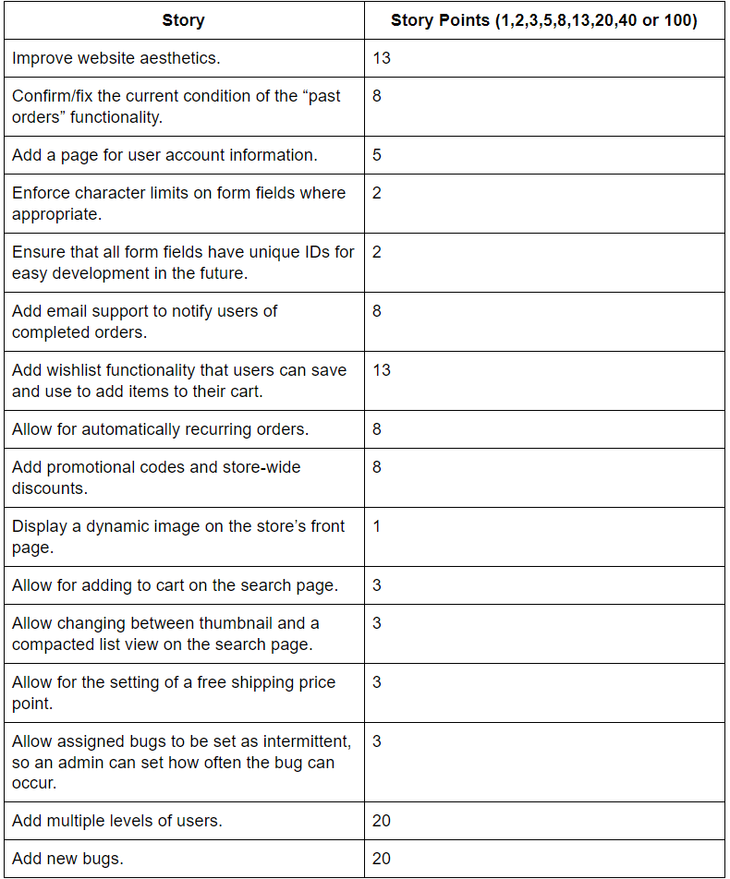
Metrics
These were our initial story point estimations.
After our meeting with the customer, we had a lot of potential user stories to address.

Slide 8
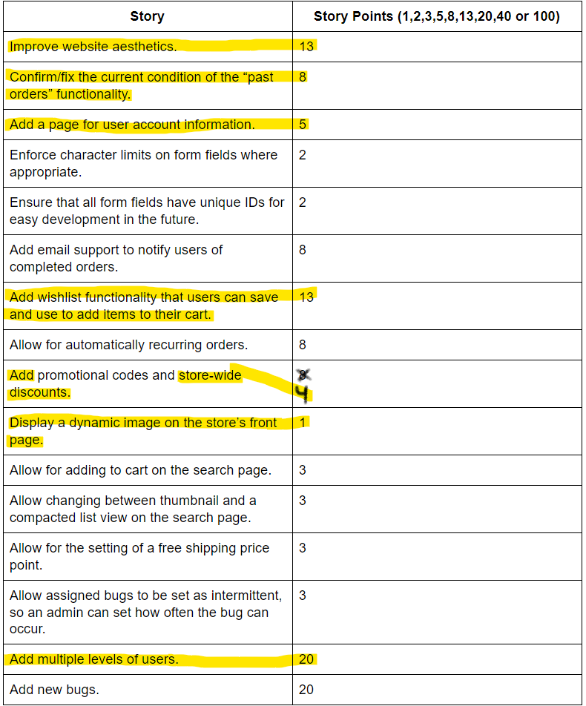
Metrics - cont.
Given the global pandemic, we had to scale back the scope of our project and focus on what we could get done based on our changed schedules and work loads.
Highlighted are the user stories we completed.

Slide 9
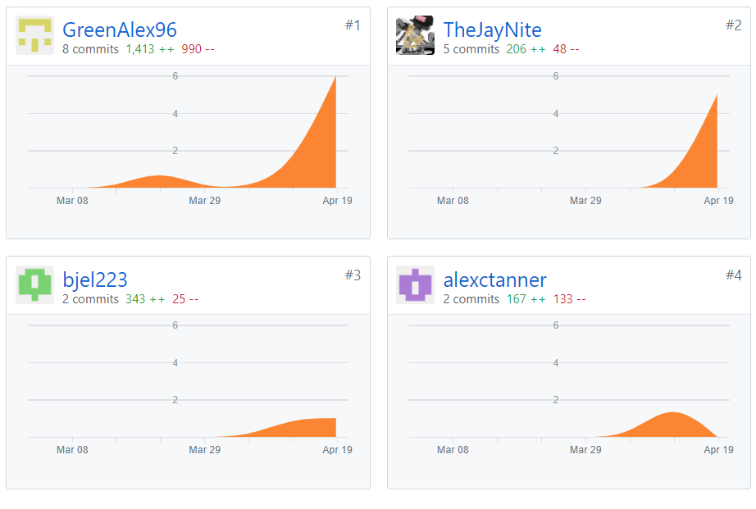
Metrics - cont.
Looking at our Github, we have changed 2,129 lines of code with 933 of those lines being brand new code.
(From March 1st to April 21st)

Slide 10
Lessons Learned
Good documentation is always helpful, for yourself and for future programmers
Good communication is the best quality a group can have
Downscoping is sometimes necessary
Building things with future maintenance in mind will always help yourself and other developers

Slide 11
Conclusion
Bugs are features too!
We hope we have delivered on as many of the user stories as we could and created real value for our customer, and hope that the next group that expands on the project finds it easy to do so.

Slide 12
Questions?

